Slide 1
Market prospects
– the future of your portfolio
Kate Faulkner Bsc(Econ) MBA CIM DipM

Slide 2
Agenda
What’s going on in the market?
Where on earth is the market going?
What do landlords need to do to
future proof their portfolio?

Slide 3
What’s going on in the market?
Property Prices

Slide 4
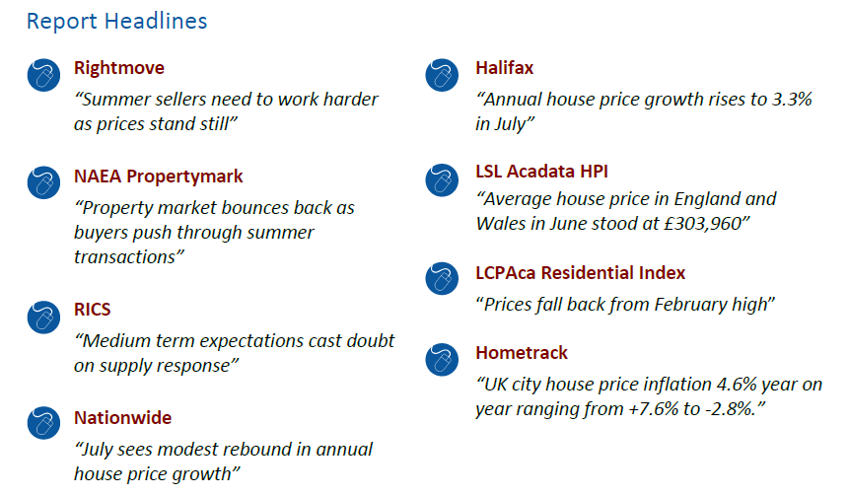


Slide 5

Where are we now?
Scotland
Credit crunch falls: -17%
Av price: £150,472
10 year growth: +3%
YoY growth: +4.8%
England
Credit crunch falls: -18%
Av price: £245,076
10 year growth: +26%
YoY growth: +2.7%
Wales
Credit crunch falls: -18%
Av price: £123,104
10 year growth: +4%
YoY growth: +4.3%
N. Ireland
Credit crunch falls -56%
Av price: £132,795
10 year change: -41%
YoY growth: +4.4%
http://landregistry.data.gov.uk

Slide 6
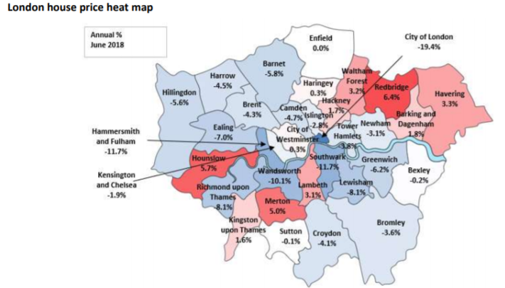
London Borough performance
Borough highs and lows
Highest growth over the last 10 years Lowest growth
Waltham Forest (+76%) Kensington & Chelsea (+39%)
City of Westminster (+70%) Tower Hamlets (+41%)
Islington (68%) Hammersmith & Fulham (+43%)
https://lsl-assets.s3.amazonaws.com/lslps/uploads/media_file/house-price-index-july18.pdf

Slide 7
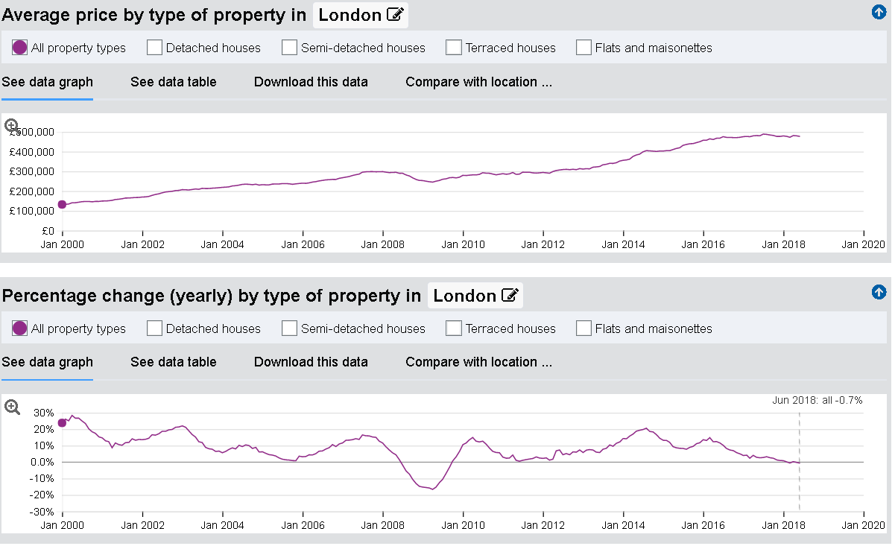
UKHPI chart for London
http://landregistry.data.gov.uk

Slide 8
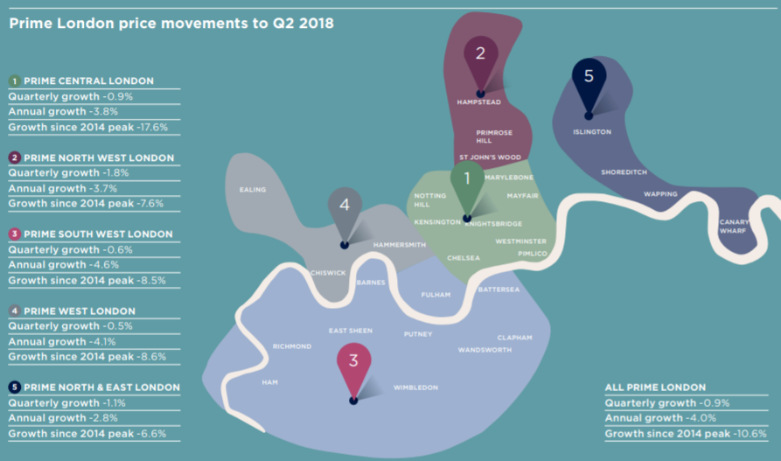
London prime market
https://pdf.euro.savills.co.uk/uk/market-in-minute-reports/market-in-minutes---prime-london-residential-july-2018.pdf

Slide 9
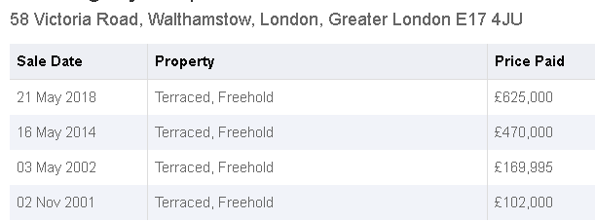
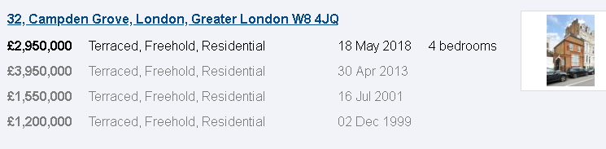
‘Wow’ and ‘ooh’
+33%
-25%

Slide 10
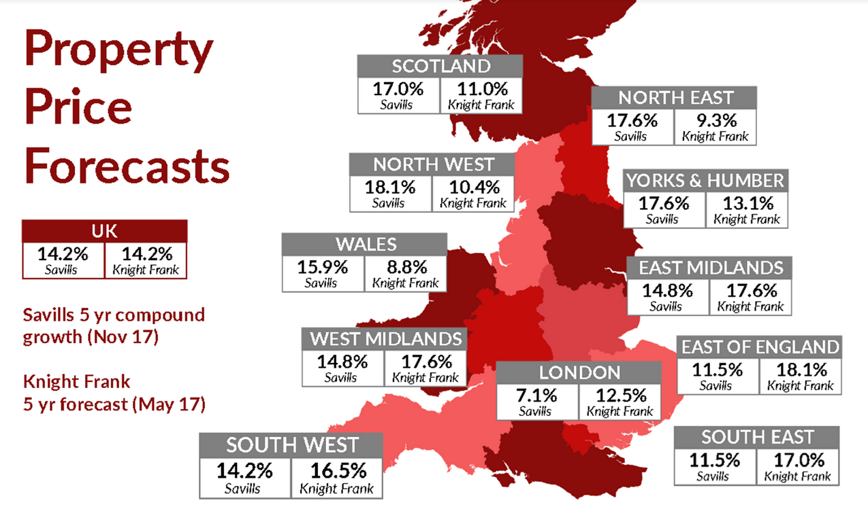
Property price forecasts

Slide 11
What’s going on in the market?
Rents and demand?

Slide 12
Where are we now?
Scotland
Av £569 to £710
Range -1.2% to +1%
North East
Av £601 to £712
Range -1.3% to 0.1%
North West
Av £601 to £712
Range +0.6% to 3.1%
Yorks & Humber
Av £579 to £676
Range +1.2% to 3.1%
Wales
Av £588 to £710
Range -1.3% to 0.2%
East Midlands
Av £631 to £663
Range +1.8% to 2.7%
West Midlands
Av £617 to £701
Range +1.1% to 3%
East of England
Av £698 to £909
Range -1.1% to +2.9%
South West
Av £686 to £818
Range -.6% to +2.2%
South East
Av £895 to £1,041
Range +1.2% to +1.5%
London
Av £1,217 to £1,564
Range -5.1% to +3.3%
Source: LSL, Homelet, Belvoir and ONS data

Slide 13
Rental trends
Tenants are naturally staying in properties longer
Tenant arrears just under 10% (Your Move)
  All time record Feb 2010 of 14.6%
Voids fairly steady
Evictions are on the rise but:-
  One agent 56% of offices carried out NO evictions
  31% carried out one eviction (Belvoir)
Landlords are selling up, not investing as much
  But not ‘falling off a cliff’
  Reasons given are tax changes and constant new legislation

Slide 14
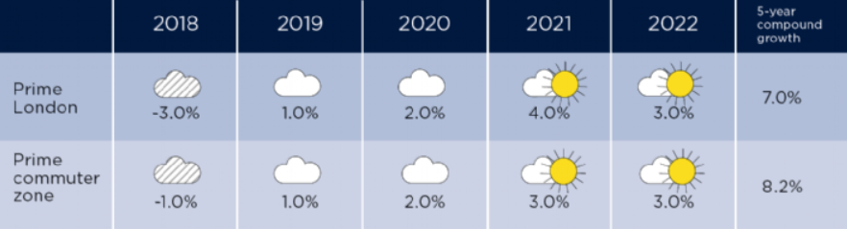
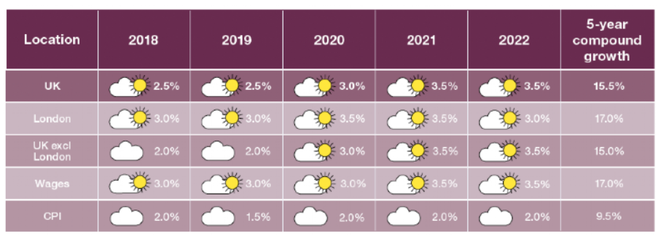
Rental Forecasts
https://www.savills.co.uk/insight-and-opinion/research-consultancy/residential-market-forecasts.aspx

Slide 15

Property price and rental summary
Rents likely to remain in line with wages
  Some growth in areas where wages can afford increase
Substantial slowdown in natural capital growth
London, home building plans are high
  90%+ are residential, could deliver 106,000 new homes
https://www.standard.co.uk/news/london/londons-soaring-skyline-skyscraper-projects-pass-500-for-first-time-as-giant-towers-planned-in-all-a3816861.html

Slide 16
Impact on landlords
May increase affordability for tenants to buy
  Could reduce tenant demand
  Brexit may reduce this further
  Likely impact low for properties in good condition
    Population growth still expected to be 9% to 2026
However
  Danger of rental/homeowner ‘stagnation’
    Tough to secure stock to grow portfolios
    Possible opportunities to purchase existing tenant stock
  Wise to build in capital growth for new deals

Slide 17
Where next?
How do you ‘future proof’ your portfolio

Slide 18
Time for everyone to re-think PRS
“People Renting Safely”
“People Renting Securely”
“A Place for Renters to be Safe”

Slide 19
The myths are busted
The Evolving Private Rented Sector: Its Contribution and Potential
Landlords, 9% are tenants
  ‘Episodic’/temporary ie life events
  Pension plan landlords
  Portfolio
  Divesting
Rental property
conditions vary

Slide 20
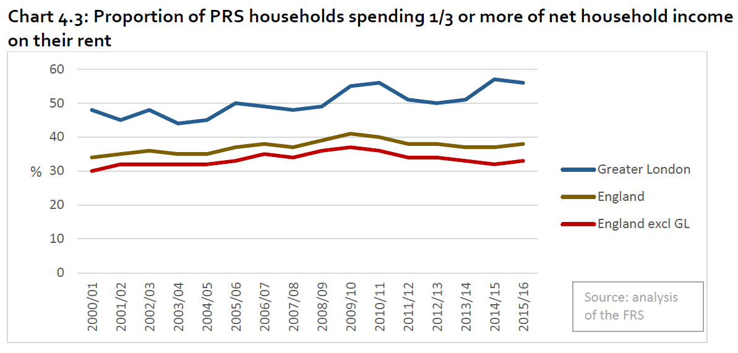
The myths are busted
The Evolving Private Rented Sector: Its Contribution and Potential
Affordability
  “PRS households in England as a whole have on average been spending slightly less than three-tenths of their net household income on their rent.”

Slide 21
The myths are busted
The Evolving Private Rented Sector: Its Contribution and Potential
Legislation and enforcement
  The law is confused
  At local authority level there can be limited will and resources to deliver effective enforcement
  Little confidence in the processes in place to secure redress and penalty.
“Picking on single elements are unlikely to succeed”
  Ending S.21 is likely to be detrimental
  Housing court won’t necessarily provide an easy path to justice

Slide 22
Growing belief that tenants and landlords interests are aligned
– As are the industry’s and government

Slide 23
Landlords need to be seen as part of the solution not the problem

Slide 24
Change, change, change
Landlords challenge: survive and thrive
Don’t just do the ‘legal minimum’
  Deliver the best property and service you can
    Get as close to EPC ‘A’ rating as practical (at least a ‘C’)
    Help tenants where you can
      Claiming benefits
      Upgrade the property, with their input
Property, financial and legal ducks in a row
New deals need a plan A, plan B probably a plan C
Keep up to date with all the changes
    Support the RLA

Slide 25


