Slide 1
Top 10 Trends ALL Investors MUST Know
Kate Faulkner BSc(Econ) MBA CIM DipM

Slide 2
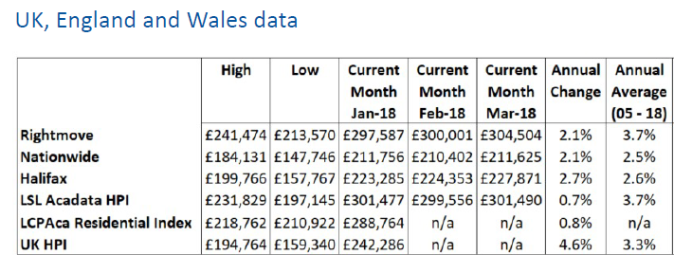
No#1: Natural capital growth is slowing
Annual average change in prices since 2000: 5.4% to 7.6% (UKHPI)

Slide 3
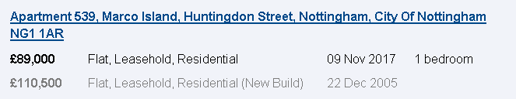
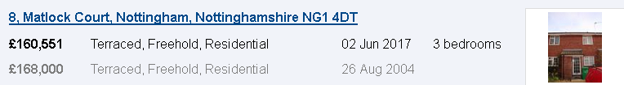
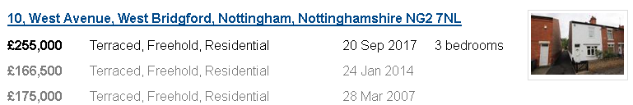
Prices: fall, stay the same, increas

Slide 4
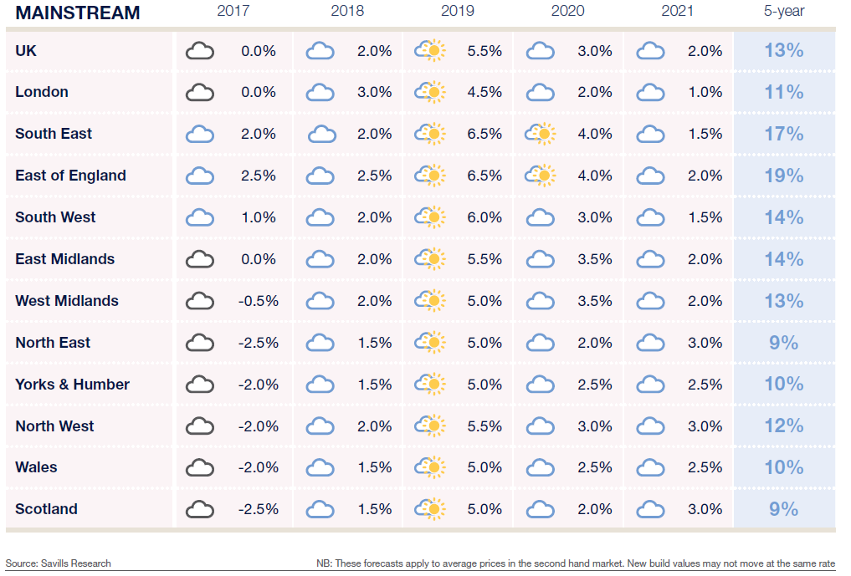
No#2: Prices to grow in line with wages

Slide 5
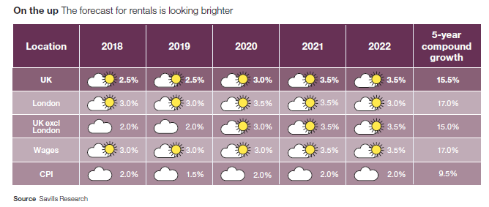
No#3: Rents mean stagnant wages for landlords

Slide 6
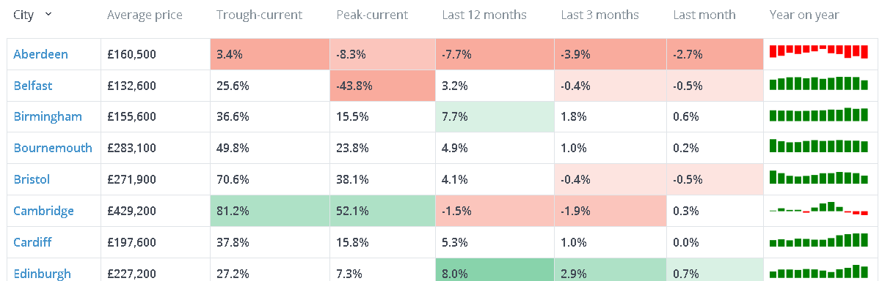
No#4: Local economics will dictate returns
https://www.hometrack.com/uk/insight/uk-cities-house-price-index/

Slide 7
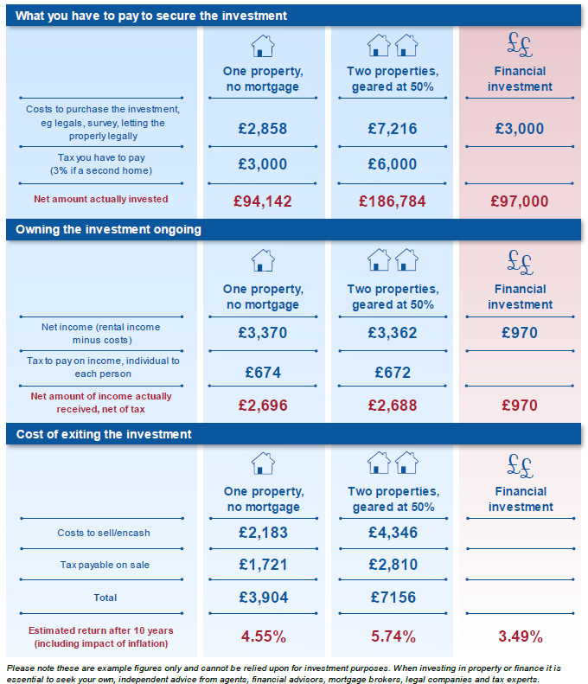
No#5: Financial returns could beat property

Slide 8
No#5: Buying, selling, investing and owning will change
In excess of 20 government proposals to change what and how we do things
  Voluntary agreements when buying/selling
  Faster and fixed times for searches/leasehold information
  Educated and qualified agents
  Transparency of referral fees
Regulation/enforcement of agents and landlords will increase
Government will see landlords as a ‘solution’ not the ‘problem’

Slide 9

No#6 Local plans will dictate supply vs demand demand
https://www.nottinghamcity.gov.uk/planning-and-building-control/planning-policy/the-local-plan-and-planning-policy/land-and-planning-policies-development-plan-document-local-plan-part-2-submission-version/

Slide 10
No#7: Property demand is changing
By 2040, nearly one in seven Britons will be over 75, according to a report by the Resolution foundation thinktank published today, which also reveals that almost a third of people born today can expect to live to 100. In 2014, the average age in the UK exceeded 40 for the first time.
Smaller homes? Warmer homes?
Ease of access to public transport? Homes for disability/dementia?
https://www.theguardian.com/membership/2017/jan/16/the-new-retirement-how-an-ageing-population-is-transforming-britain

Slide 11

No#8: The Builders are coming
There are 117,893 build to rent units either completed or planned across the UK
A further 63,955 have planning permission.
https://www.bpf.org.uk/what-we-do/bpf-build-rent-map-uk

Slide 12
No#9: Taxes will remain complicated
Property tax is complicated
  Can change at each budget
  30 pages explaining how stamp duty is charged
  3 different levels of stamp duty
    Wales, England and Scotland
  Expert advice is essential
    Take it BEFORE taxes change, not after

Slide 13
No#10: Buying, selling, investing and owning will change
In excess of 20 government proposals to change what and how we do things
  Voluntary agreements when buying/selling
  Faster and fixed times for searches/leasehold information
  Educated and qualified agents
  Transparency of referral fees
Regulation/enforcement of agents and landlords will increase
Government will see landlords as a ‘solution’ not the ‘problem’

Slide 14
Summary
Tip 1
  Don’t listen to salesmen when investing
Tip 2
  Take financial advice first, then decide if property is right for you now, and in the future
Tip 3
  Get specialist tax advice
Tip 4
  Do your own research or pay a RICs surveyor to do it for you
Tip 5
  Keep up with changes
    www.propertychecklists.co.uk or www.designsonproperty.co.uk
    Member of a landlord association
    Join groups such as ‘Property Tribes’
    Go to exhibitions
    Pay someone who knows what they are doing

Slide 15

Email: enquiries@designsonproperty.co.uk

